Slide 1
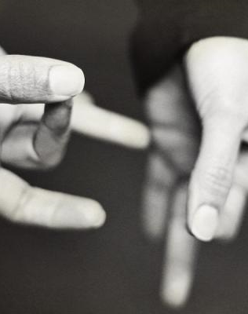

Sign language conversion
UNDER THE GUIDANCE OF
Mr. Vishal Gupta (Head M.C.A Department)
Presented By : Aniket Sharma (2022D1R013)
Divyansh Gupta (2022D1R015)

Slide 2


index
Project introduction
Technology used
Library used
Disadvantages of previous system
Advantages of proposed system
Project description
Snapshots of project
References

Slide 3

Project introduction

Slide 4
Project introduction
Communication is a fundamental aspect of human interaction, yet for individuals who are Deaf and Dumb, Sign language is their primary means of expression and comprehension. It's a beautiful language that uses hand movements, facial expressions, and body language to convey meaning. However, not everyone knows how to use or understand sign language, which can create barriers in communication and make it challenging for deaf individuals to fully participate in conversations and interactions.
To address this issue, our project utilizes technology to bridge the communication gap for the Deaf and Dumb community. Our project aims to revolutionize communication accessibility for the deaf-dumb community through the innovative use of machine learning and Python programming.
Key libraries such as OpenCV, Scikit-learn and Media pipe are integral to the development process, facilitating the creation and training of the model. Through a combination of image processing techniques and advanced algorithms, sign language is analyzed, enabling the model to accurately interpret gestures and generate corresponding textual representations.
Furthermore, the integration of text-to-speech libraries like Pyttsx3 improves accessibility by converting the generated text into audio output.

Slide 5

technology used

Slide 6
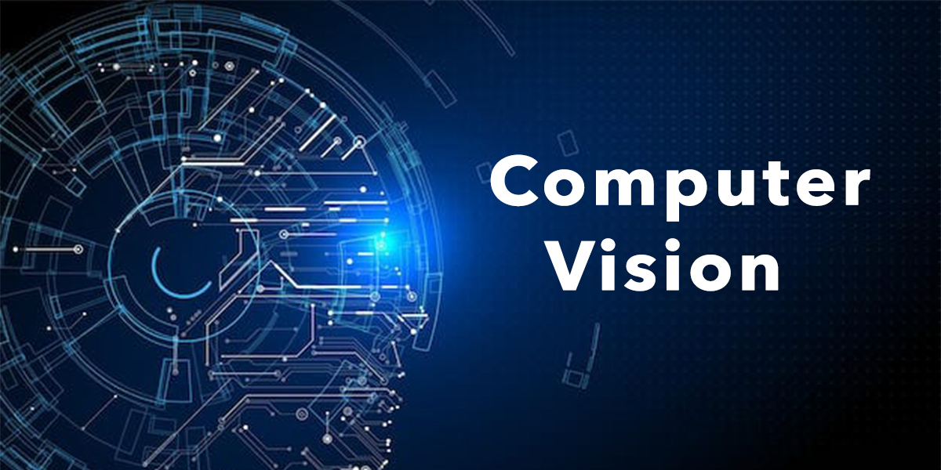

technology used
01
COMPUTER VISION
02
OBJECT DETECTION
Computer vision enables computers to understand and interpret visual data from images or videos, using techniques like image processing and machine learning. It's crucial for tasks such as object recognition, image classification, and scene understanding in diverse applications.
Object detection, a technology closely associated with computer vision and image processing, focuses on identifying instances of specific semantic objects in digital images and videos. It finds widespread applications in computer vision, including object tracking and various other tasks.

Slide 7
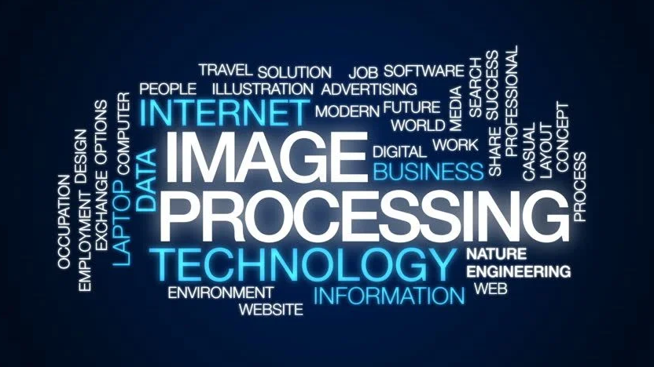

technology used
03
IMAGE PROCESSING
04
TEXT TO SPEECH
Image processing refers to the technique of executing operations on an image to obtain an improved version or to extract valuable information from it. It falls under the category of signal processing, where the input is an image and the output can be either an image or features related to that image.
Text-to-speech (TTS) is a computer technology that converts written text into spoken words. It enables computers to audibly communicate information, finding applications in accessibility tools, virtual assistants, and interactive systems by converting text into natural-sounding speech.

Slide 8

Library used

Slide 9


Library used
OPEN-CV
MEDIAPIPE
OpenCV is a video and image processing library and it is used for image and video analysis, like facial detection, license plate detection, photo editing, advanced robotic vision, and many more.
The aim is to interpret sign language gestures. In order to detect hands, we will use OpenCV to recognize them.
Media Pipe is an open-source framework developed by Google that offers customizable solutions. It offers pre-built components for tasks like object detection, hand tracking, etc. enabling developers to create applications easily.
By utilizing Media Pipe, we'll detect and analyze hand markings, enabling the conversion of these gestures into meaningful signs or text.

Slide 10

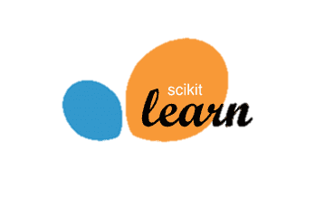
Library used
NUMPY
SKLEARN
NumPy is a Python library used for numerical computing and scientific computing. It provides support for large, multi-dimensional arrays and matrices, along with a large collection of mathematical functions to operate on them.
The main aim of using NumPy is to store and manipulate hand landmarks coordinates as arrays.
The scikit-learn is a Python library extensively utilized for machine learning tasks. It provides a wide range of machine learning algorithms and tools for data preprocessing, model training, and prediction.
Whether it’s classification, regression, clustering or other tasks, scikit-learn provides a robust and user-friendly framework. From scikit-learn we use Random Forest algorithm for training model.

Slide 11


Library used
TKINTER
PYTTSX3
Tkinter is a Python library commonly used for building graphical user interfaces (GUIs). It provides a simple and intuitive way to create windows, dialogs, buttons, menus, and other GUI elements.
It help us by providing a comprehensive set of widgets and layout managers to design and arrange GUI components efficiently.
Pyttsx3 is a Python library used for text-to-speech (TTS) conversion. It provides a simple and efficient way to convert text strings into spoken audio
It offers a straightforward API for converting text to speech, allowing developers to customize parameters such as voice selection, speech rate, and volume.

Slide 12

Dis-advantages of previous System

Slide 13
Dis-Advantages of previous System
Limited Accuracy: Many existing sign language conversion systems may struggle with accuracy, especially when it comes to recognizing complex gestures. This can result in errors in transcription, leading to misunderstandings and miscommunications.
Lack of Real-Time Transcription: Some systems may not offer real-time transcription capabilities, causing delays in communication. This limitation can hinder spontaneous conversations, making it harder for deaf-mute individuals to engage in smooth conversations.
Dependence on Environment: Certain systems may be highly sensitive to their surroundings, leading to variations in accuracy based on factors such as shadows, glare, or background clutter.
Single-Word Translation Limitation: Previous sign language detection systems were limited to translating single words into signs, meaning that only one sign corresponded to one word. However, this approach lacked the ability to generate full sentences.

Slide 14

advantages of proposed System

Slide 15
Advantages of proposed System
Enhanced Accuracy: Our new sign language detection system utilizes advanced machine learning algorithms and image processing techniques for superior accuracy, minimizing errors and enhancing performance.
Sentence Generation Capability: Unlike previous systems that were restricted to translating single words into signs, our new model can generate full sentences, allowing for more comprehensive and natural communication.
Faster Processing: Our system processes information faster, even in different environments, which helps make conversations quicker and easier in real-time, regardless of the surroundings.
Output in Audio Format: Our system not only converts sign language into text but also offers text-to-speech, turning written words into clear, natural-sounding audio. This makes communication more accessible and effective for everyone involved.

Slide 16
Project description

Slide 17
Project description
Sign language detection refers to the process of identifying and interpreting hand movements, gestures, and facial expressions used in sign languages. This typically involves using computer vision techniques and machine learning algorithms to analyze video input and recognize the gestures being made by a signer. Sign language detection systems often rely on Machine learning models for classification and interpretation. The goal of sign language detection is to translate these gestures into understandable text or speech, enabling communication between sign language users and non-signing individuals.
Our project, Sign Language Detection, utilizes the Media pipe framework for hand gesture recognition and a Random Forest classifier for gesture classification. By capturing and interpreting sign language gestures in real-time, we generate corresponding text representations within the software, which can be further converted into audible speech. This system breaks down communication barriers.

Slide 18
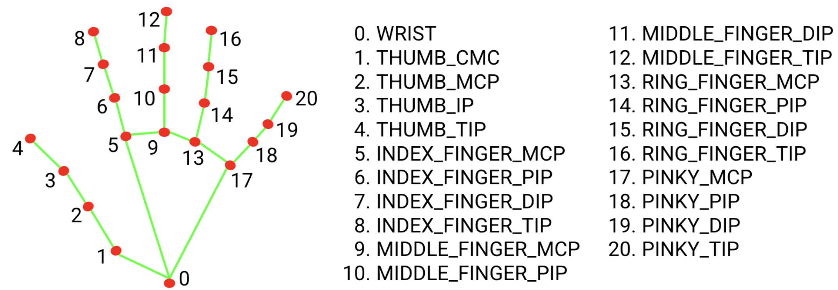
Project description
The Media Pipe Hand Landmark task enables the detection of hand landmarks in an image. The model bundle consists of a palm detection model and a hand landmarks detection model. The palm detection model identifies the presence and location of hands within the input image, while the hand landmarks detection model precisely localizes 21 key points on the hand, including knuckle coordinates. Additionally, it has the capability to detect multiple hands within the image ( Max 2 ).
Notes:
Mediapipe hand landmark model uses
Combination of two models i.e. palm detection and hand landmarkings
Pinky Dip: This refers to the distal interphalangeal joint (DIP joint) of the little finger. It's the joint closest to the tip of the finger.
Tip: The very end or extremity of the finger.
Pip: This stands for the proximal interphalangeal joint (PIP joint). It's the joint in the middle of the finger, between the proximal and middle phalanges.
MCP: This stands for the metacarpophalangeal joint. It's the joint that connects the fingers to the hand, located at the base of the fingers.
These are common terms used in finger anatomy

Slide 19
Working
Input Acquisition
The system initiates by capturing input exclusively through the webcam. This live feed serves as the primary source of data for the project.
Hand Detection
The system utilizes computer vision techniques supported by libraries like OpenCV and Media Pipe to detect and track hand gestures in real-time. This process involves identifying where the hands are located, how they move, and their shape within the video frames.
Feature Extraction
Subsequently, Media pipe's hand detection model generates hand landmarks, comprising key points on the hand. These landmarks serve as the basis for extracting relevant features, such as the positions of specific points on the hand, the overall shape of the hand, or the trajectory of hand movements.
Gesture Classification
A Random Forest classifier is used to analyze the extracted features. Trained on a dataset of sign language gestures, the Random Forest classifier is proficient in discerning and categorizing various gestures based on the distinctive features extracted from the hand landmarks.
Text Generation
Upon classifying a gesture, the system generates the corresponding text representation of the sign language gesture. This could involve mapping each recognized gesture to a predefined text or symbol.
Text-to-Speech Conversion
To make the interpretation accessible to non-signing individuals, the generated text is converted into audible speech. This conversion can be achieved using pyttsx3.
Text Generation
Upon classifying a gesture, the system generates the corresponding text representation of the sign language gesture. This could involve mapping each recognized gesture to a predefined text or symbol.
Text-to-Speech Conversion
To make the interpretation accessible to non-signing individuals, the generated text is converted into audible speech. This conversion can be achieved using pyttsx3.

Slide 20
Working
Input Acquisition
The system initiates by capturing input exclusively through the webcam. This live feed serves as the primary source of data for the project.
Hand Detection
The system utilizes computer vision techniques supported by libraries like OpenCV and Media Pipe to detect and track hand gestures in real-time. This process involves identifying where the hands are located, how they move, and their shape within the video frames.
Feature Extraction
Subsequently, Media pipe's hand detection model generates hand landmarks, comprising key points on the hand. These landmarks serve as the basis for extracting relevant features, such as the positions of specific points on the hand, the overall shape of the hand, or the trajectory of hand movements.
Gesture Classification
A Random Forest classifier is used to analyze the extracted features. Trained on a dataset of sign language gestures, the Random Forest classifier is proficient in discerning and categorizing various gestures based on the distinctive features extracted from the hand landmarks.
Text Generation
Upon classifying a gesture, the system generates the corresponding text representation of the sign language gesture. This could involve mapping each recognized gesture to a predefined text or symbol.
Text-to-Speech Conversion
To make the interpretation accessible to non-signing individuals, the generated text is converted into audible speech. This conversion can be achieved using pyttsx3.
Text Generation
Upon classifying a gesture, the system generates the corresponding text representation of the sign language gesture. This could involve mapping each recognized gesture to a predefined text or symbol.
Text-to-Speech Conversion
To make the interpretation accessible to non-signing individuals, the generated text is converted into audible speech. This conversion can be achieved using pyttsx3.

Slide 21
Working
Input Acquisition
The system initiates by capturing input exclusively through the webcam. This live feed serves as the primary source of data for the project.
Hand Detection
The system utilizes computer vision techniques supported by libraries like OpenCV and Media Pipe to detect and track hand gestures in real-time. This process involves identifying where the hands are located, how they move, and their shape within the video frames.
Feature Extraction
Subsequently, Media pipe's hand detection model generates hand landmarks, comprising key points on the hand. These landmarks serve as the basis for extracting relevant features, such as the positions of specific points on the hand, the overall shape of the hand, or the trajectory of hand movements.
Gesture Classification
A Random Forest classifier is used to analyze the extracted features. Trained on a dataset of sign language gestures, the Random Forest classifier is proficient in discerning and categorizing various gestures based on the distinctive features extracted from the hand landmarks.
Text Generation
Upon classifying a gesture, the system generates the corresponding text representation of the sign language gesture. This could involve mapping each recognized gesture to a predefined text or symbol.
Text-to-Speech Conversion
To make the interpretation accessible to non-signing individuals, the generated text is converted into audible speech. This conversion can be achieved using pyttsx3.
Text Generation
Output Presentation
Upon classifying a gesture, the system generates the corresponding text representation of the sign language gesture. This could involve mapping each recognized gesture to a predefined text or symbol.
The translated text and/or synthesized speech are presented to the user through a graphical user interface. This could include displaying the translated text on a screen or playing the synthesized speech through speakers or headphones.
Text-to-Speech Conversion
Continuous Operation
To make the interpretation accessible to non-signing individuals, the generated text is converted into audible speech. This conversion can be achieved using pyttsx3.
The system operates continuously, processing new input frames, detecting gestures, translating them into text, and presenting the results to the user in real-time.

Slide 22
Working
Input Acquisition
The system initiates by capturing input exclusively through the webcam. This live feed serves as the primary source of data for the project.
Hand Detection
The system utilizes computer vision techniques supported by libraries like OpenCV and Media Pipe to detect and track hand gestures in real-time. This process involves identifying where the hands are located, how they move, and their shape within the video frames.
Feature Extraction
Subsequently, Media pipe's hand detection model generates hand landmarks, comprising key points on the hand. These landmarks serve as the basis for extracting relevant features, such as the positions of specific points on the hand, the overall shape of the hand, or the trajectory of hand movements.
Gesture Classification
A Random Forest classifier is used to analyze the extracted features. Trained on a dataset of sign language gestures, the Random Forest classifier is proficient in discerning and categorizing various gestures based on the distinctive features extracted from the hand landmarks.
Text Generation
Upon classifying a gesture, the system generates the corresponding text representation of the sign language gesture. This could involve mapping each recognized gesture to a predefined text or symbol.
Text-to-Speech Conversion
To make the interpretation accessible to non-signing individuals, the generated text is converted into audible speech. This conversion can be achieved using pyttsx3.
Output Presentation
The translated text and/or synthesized speech are presented to the user through a graphical user interface. This could include displaying the translated text on a screen or playing the synthesized speech through speakers or headphones.
Continuous Operation
The system operates continuously, processing new input frames, detecting gestures, translating them into text, and presenting the results to the user in real-time.

Slide 23
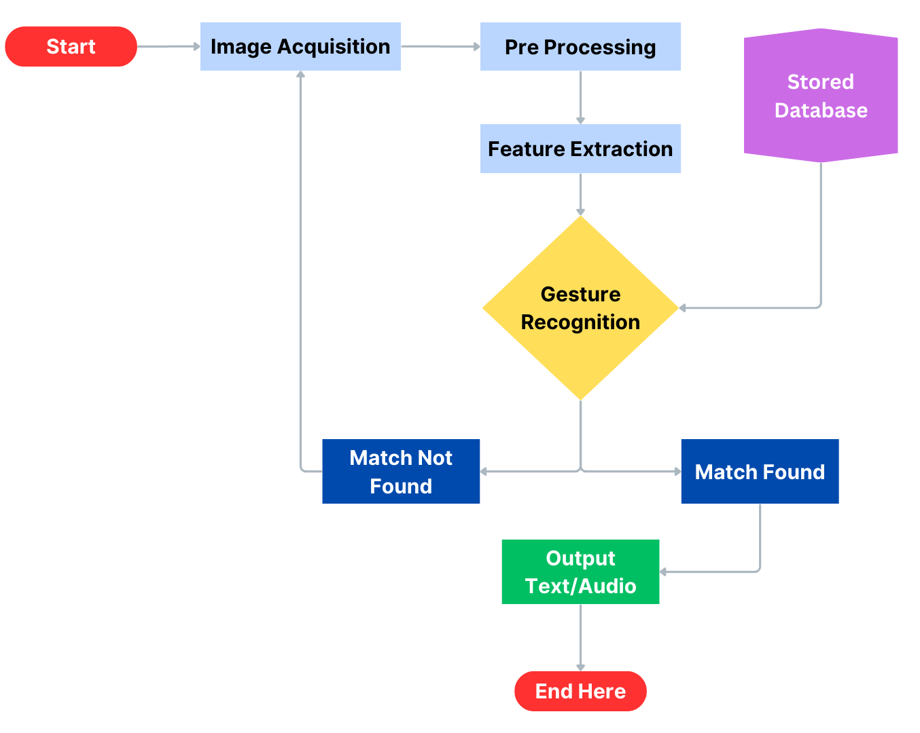
Flow chart

Slide 24

Snapshots of project

Slide 25
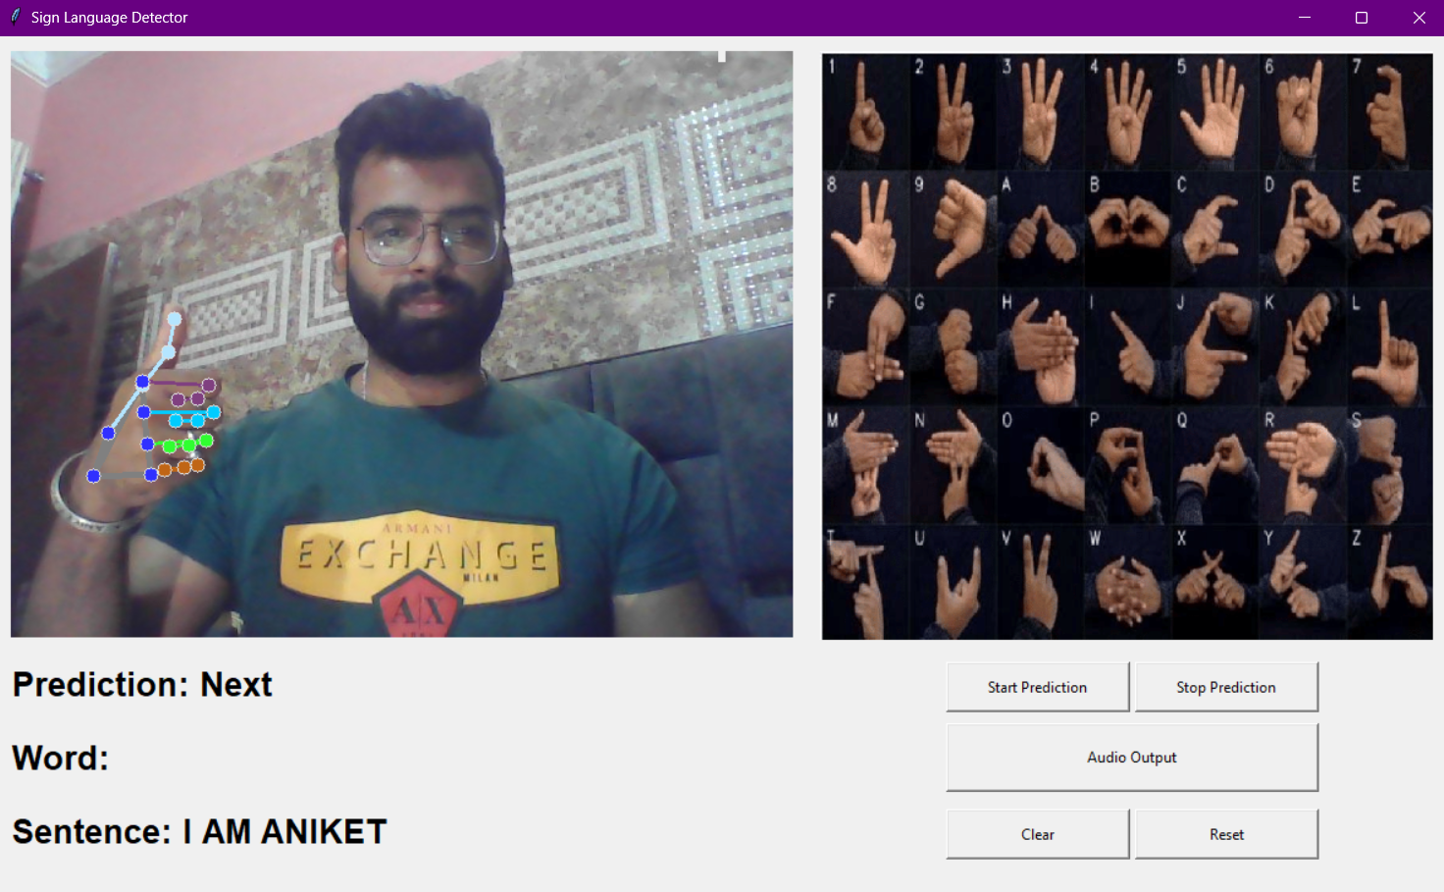
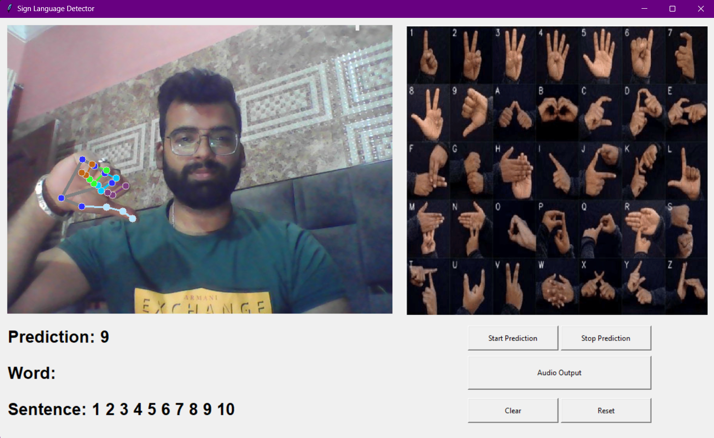
Snapshots of project

Slide 26

References

Slide 27
References
https://www.geeksforgeeks.org/opencv-overview/
https://github.com/google/mediapipe/blob/master/docs/solutions/hands.md
https://www.tutorialspoint.com/scikit_learn/scikit_learn_randomized_decision_trees.htm
https://www.javatpoint.com/python-tkinter
https://chat.openai.com/
https://www.youtube.com/

Slide 28


